Slide 1


Airline ticket booking
PRERIT
SMITA
SAGAR

Slide 2
Capstone project
- Understanding
- Application components
- Application flow
- Contract API’s
- Demo Screens

Slide 3



Understanding
Build brief blockchain based airline ticket booking system,
which consist private blockchain, contracts and execute contract based on ticket booking operation.
CREATE BOOKING SYSTEM USING BLOCKCHAIN AND INTEGRATE CONTRACT
CREATE PRIVATE BLOCKCHAIN
CREATE CONTRACT

Slide 4
Why blockchain approach?
Bring trust in contract between customer and airline with predefined penalties and refunds.
Contract rules defined by the airline consortium to encourage transparency
The smart contract acts like an Escrow, allowing final settlement after usage of the ticket.
Possibility to define different refund rules transparently
Bringing trust with blockchain consensus mechanism

Slide 5






Application components
Browser
dApps
Web Application
Chain :7545
Truffle - contract

Slide 6






Application key functions
Deploy Contracts
Airline Consortium
Add flights to contract
Update flight status
Claim ticket price
Cancel flight
Airline
Book ticket
Cancel ticket
Get refund
Customer

Slide 7
Application flow
3. Book Tickets
Smart Contract on
Private Ethereum Blockchain
4.Cancel Tickets
Airline Consortium
7. Claim Refund
1. Deploy Contract
Customer1
2. Add Flight tickets
5. Cancel Flight
6. Update Flight Status
8. Claim Ticket Price
Airline1
Airline2
Airline3

Slide 8





Application flow
AWS
Browser
Metamask
Node
Customer
Node
TRUFFLE
Airline
Node
BLOCKCHAIN
S3
Airline Consortium

Slide 9
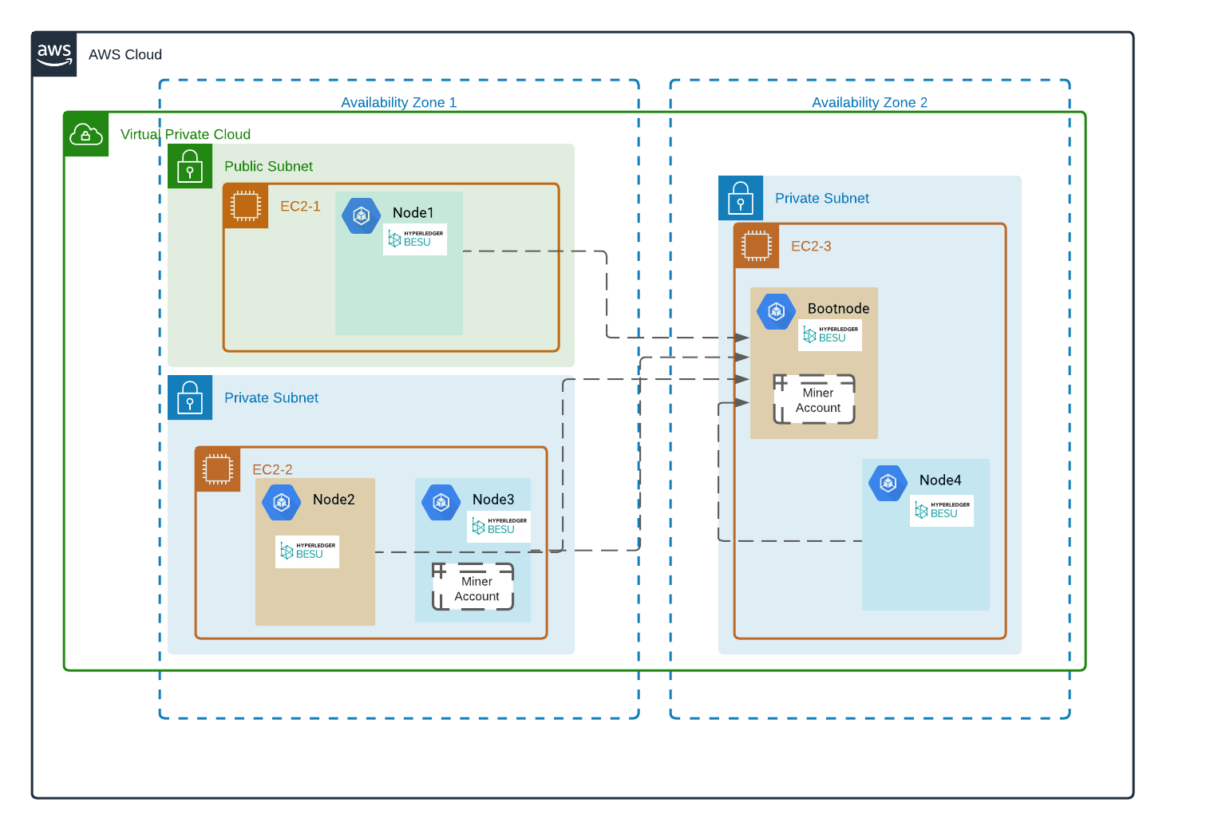
Architecture

Slide 10
Contract API’s
There are two main contracts:
Ticket Management Contract, which comprise of below three solidity files:
tickets_manager.sol
flight.sol
ticket.sol
Refund/Penalty Rules Contract, which is written in below solidity file:
refund_rules.sol
The tickets_manager.sol file contains all the public APIs which are used for interaction with Airlines and Customers accounts to the contract.
The refund_rules.sol file contains all the rules related to refund/penalties. This contract can be compiled and deployed separately on the blockchain. After deploying this, we need to inject the address of this deployed contract into main Ticket Management Contract to be utilized. This way we can change the refund rule at runtime without making any change in main Ticket Management Contract.

Slide 11
Injecting Refund/Penalty Rules to
the main Contract
Airline consortium deploys the refund_rules.sol contract and tickets_manager.sol contract.
After deploying above two contracts on the blockchain, we need to inject the refund_rules contract
address into tickets_manager contract using it’s below API:
update_refund_rules(
_refund_rules_address = 0xd9145CCE52D386f254917e481eB44e9943F39138
)
After this step, now the rules written in the refund_rules.sol contract will be applied, when a
Customer or Airline wants to claim the ticket prices.

Slide 12
Adding flights by airlines
An airline account can add a new flight to the smart contract using below API.
The flight_id_ is a unique identifier for a flight and only one such id can be present.
add_flight(
flight_id_ = 0x78afef6b05f41bc1bb14ccee8b253c737ccf4e9d76f33a1c56ca332a1bd550ed,
flight_time_ = 100000,
total_seats_ = 100,
price_per_seats_ = 3000000000000000000
)
Desired Output: Returns true on success.

Slide 13
Booking tickets by Customers
A customer account can book seats in an existing flight via the smart contract using below API.
We need to pass the exact amount/payment for the ticket in “Value” parameter while calling this API. For example - Value should be 6000000000000000000 for 2 seats in this ppt example.
book_ticket(
flight_id_ = 0x78afef6b05f41bc1bb14ccee8b253c737ccf4e9d76f33a1c56ca332a1bd550ed,
requested_seat_count_ = 2
)
Desired Output:
Returns PNR number on success.
Ticket price should be deducted from customer account.

Slide 14
Cancel tickets by Customers
A customer account can cancel a booked ticket using below API.
cancel_ticket(
flight_id_= 0x78afef6b05f41bc1bb14ccee8b253c737ccf4e9d76f33a1c56ca332a1bd550ed,
pnr_= 1,
now_= 13500 // This is current timestamp when this API is called.
)
Desired Output:
Customer account should reflect with a refund amount after deducting some percentage of penalty on the basis of time when the ticket was cancelled by the customer.
The penalty rules are defined in refund_rules.sol contract.

Slide 15
Update Cancel status of flight by airline
An airline account can update it’s flight status to CANCELLED using below API.
The airline can update the status only within 24 hours of the flight start time.
cancel_flight(
flight_id_=0x78afef6b05f41bc1bb14ccee8b253c737ccf4e9d76f33a1c56ca332a1bd550ed,
now_=110000 // This is current timestamp when this API is called.
)
Desired Output:
The flight status is set to CANCELLED.

Slide 16
Update ON-TIME status of flight by airline
An airline account can update it’s flight status to ON-TIME using below API.
The airline can update the status only within 24 hours of the flight start time.
update_flight_status(
flight_id_=0x78afef6b05f41bc1bb14ccee8b253c737ccf4e9d76f33a1c56ca332a1bd550ed,
status_ = 0, // The ‘0’ is the status value for ON-TIME.
delayed_time_ = 0, // This is a don’t care parameter in this case and can be ignored.
now_=110000 // This is current timestamp when this API is called.
)
Desired Output:
The flight status is set to ON-TIME.

Slide 17
Update DELAYED status of flight by airline
An airline account can update it’s flight status to DELAYED using below API.
The airline can update the status only within 24 hours of the flight start time.
update_flight_status(
flight_id_=0x78afef6b05f41bc1bb14ccee8b253c737ccf4e9d76f33a1c56ca332a1bd550ed,
status_ = 1, // The ‘1’ is the status value for DELAYED.
delayed_time_ = 103600, // This is the new departure time of the flight.
now_=110000 // This is current timestamp when this API is called.
)
Desired Output:
The flight status is set to DELAYED.

Slide 18
Claimed refund by customer
A customer account can claim refund for his ticket using below API.
The claim for refunds can be made only after 24 hours of flight departure time.
claim_refund(
flight_id_=0x78afef6b05f41bc1bb14ccee8b253c737ccf4e9d76f33a1c56ca332a1bd550ed,
pnr_= 1, // The PNR number of the ticket.
now_=190000 // This is current timestamp when this API is called.
)
Desired Output:
Customer account should be reflected with a refund amount calculated as per the rules defined in refund_rules.sol contract.

Slide 19
Claimed ticket prices by airline
An airline account can claim ticket price for booked tickets using below API.
The claim for tickets by airline can be made only after 24 hours of flight departure time.
claim_ticket_price(
flight_id_=0x78afef6b05f41bc1bb14ccee8b253c737ccf4e9d76f33a1c56ca332a1bd550ed,
pnr_= 1, // The PNR number of the ticket.
now_=190000 // This is current timestamp when this API is called.
)
Desired Output:
Airline account should be reflected with an amount calculated as per the rules defined in refund_rules.sol contract.

Slide 20
Thank you

